Slide 1
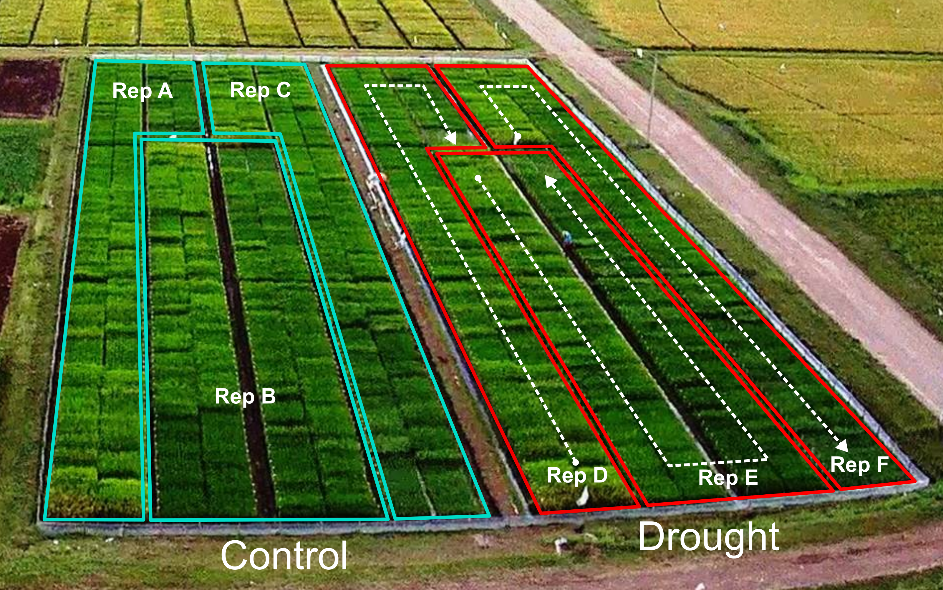

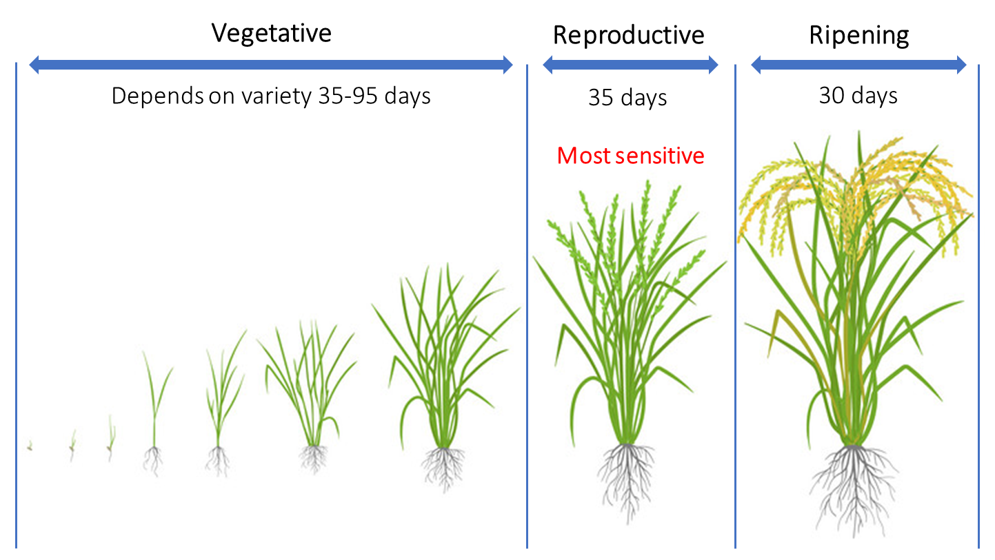
Field experiment
Indica rice diversity panel (approx. 300 lines, modern and traditional varieties).
Two dry seasons.
Well-watered (control) and water-deficit (drought) treatments.
Two-weeks stress at the flowering stage.
Grain yield performance determined at harvest.
Notes:
PRAY indica panel: modern and traditional accessions and landraces.
Flowering is the most sensitive developmental stage to stress in rice (as in most of cereals) → even a small water-deficit can result in a relevant yield loss. Severe drought at this stage can induce spikelet sterility and complete yield loss.

Slide 2
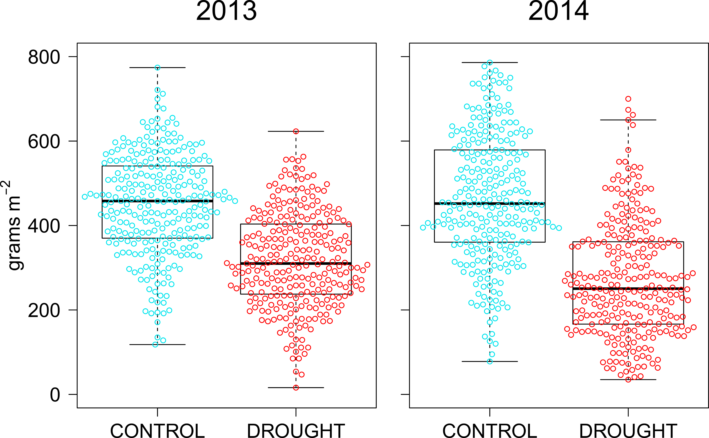
Field experiment
Indica rice diversity panel (approx. 300 lines, modern and traditional varieties).
Two dry seasons.
Well-watered (control) and water-deficit (drought) treatments.
Two-weeks stress at the flowering stage.
Grain yield performance determined at harvest.
Grain yield
GY_{LOSS} = 29.3%
GY_{LOSS} = 42.0%
Notes:
PRAY indica panel: modern and traditional accessions and landraces.
Flowering is the most sensitive developmental stage to stress in rice (as in most of cereals) → even a small water-deficit can result in a relevant yield loss. Severe drought at this stage can induce spikelet sterility and complete yield loss.

Slide 3
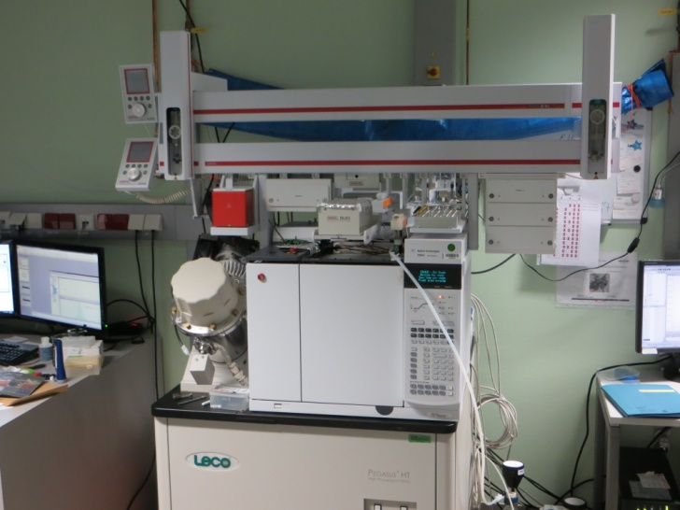
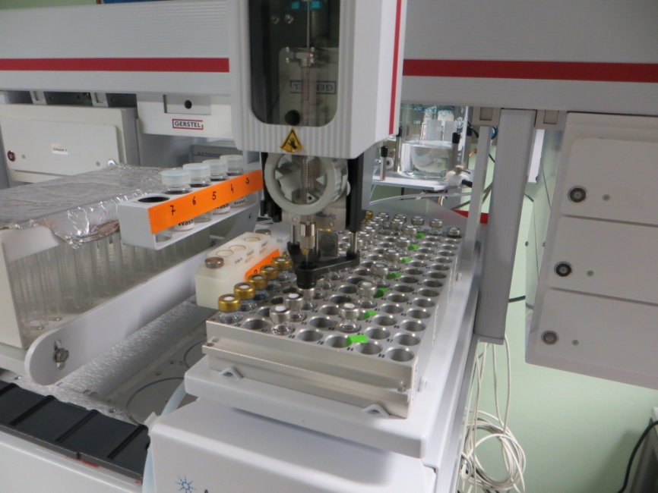
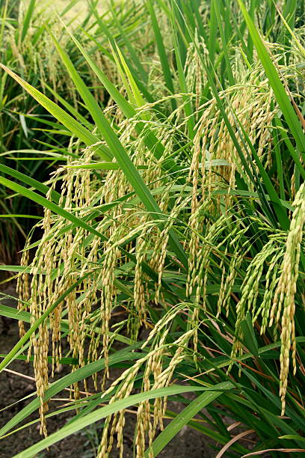
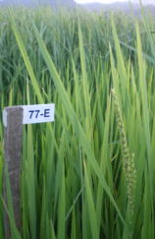
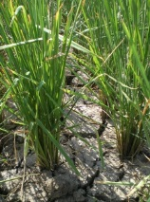
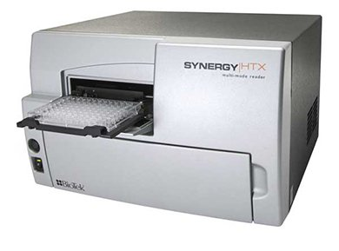
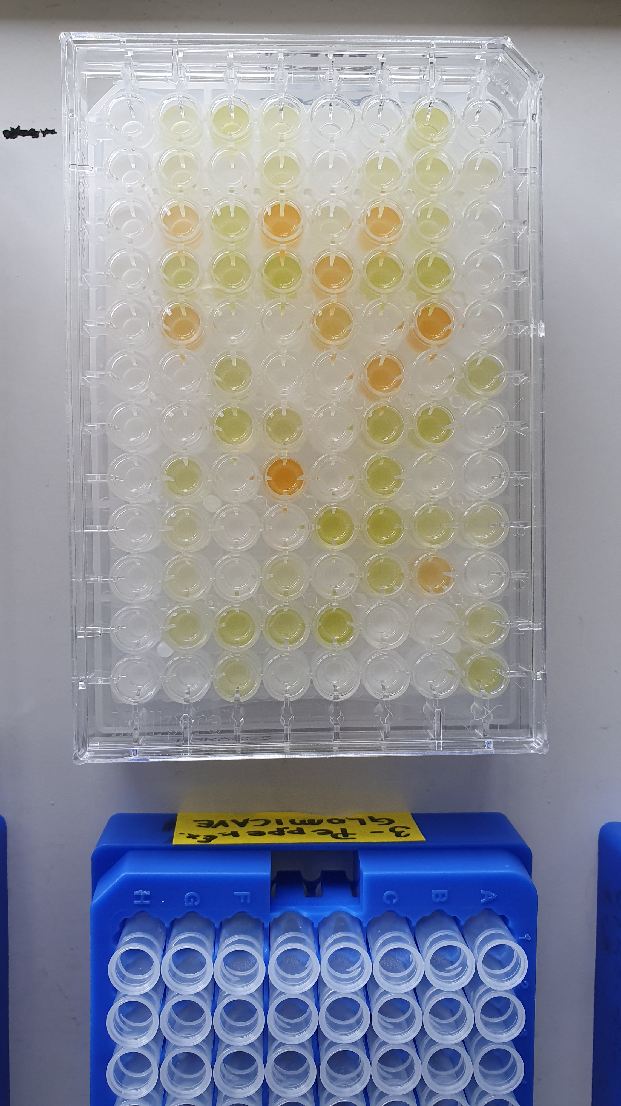
Melandri et al., (2019). J Exp Bot Melandri et al., (2022). Plant Phys
GC-TOF-MS (polar metabolites)
91 primary metabolites: 24 amino acids, 37 organic acids, 22 sugars, 8 others
Spectrophotometry (oxidative stress markers/enzyme activities)
16 enzyme activities : AO, APX, CAT, DHAR, MDHAR, Frxs, GOX, GPX, GR, Grxs, GST, HPR, POX, Prxs, SOD, Trxs.
4 oxidative stress markers: MDA, Protein oxidation (carbonylation), TAC (Trolox test), Polyphenols
Metabolic and oxidative stress profiling
FLAG LEAF
SAMPLING
GC TOF MS for metabolomics
CONTROL
MetabOxi
(111 biochemical variables)
DROUGHT
Spectrophotometric assays for oxidative stress status
It supplies photosynthetic products to the panicle.
Short time window on the last day of stress

Slide 4
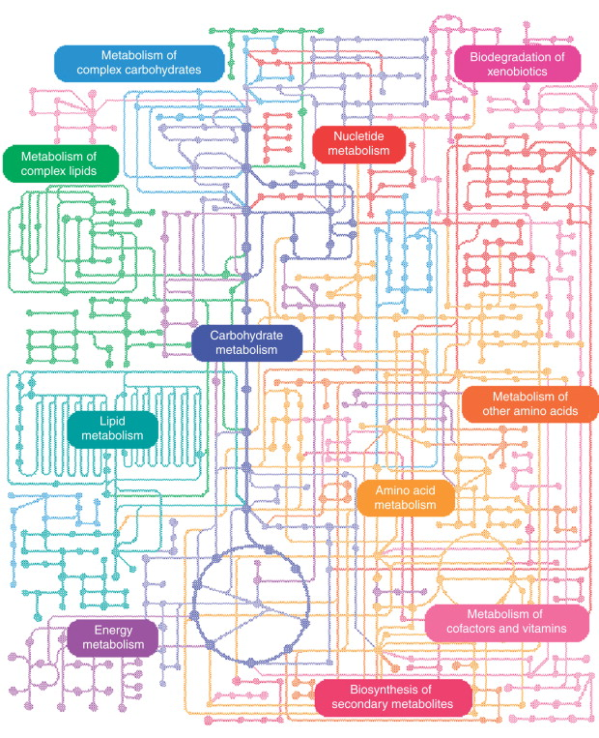
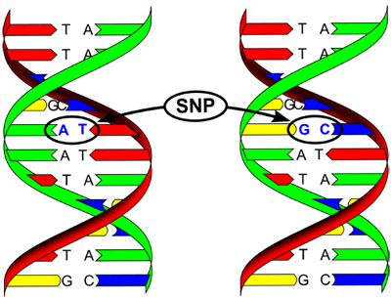
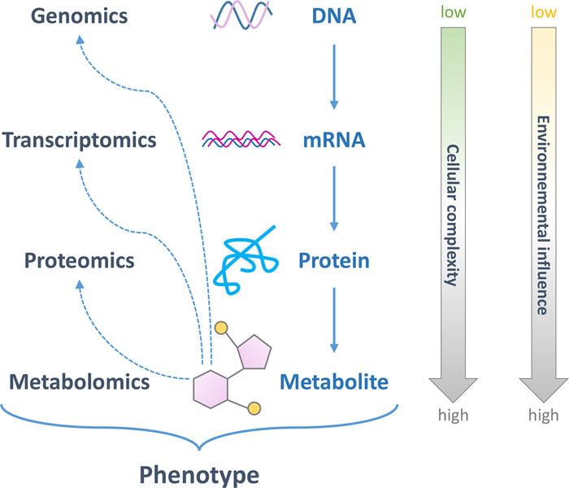
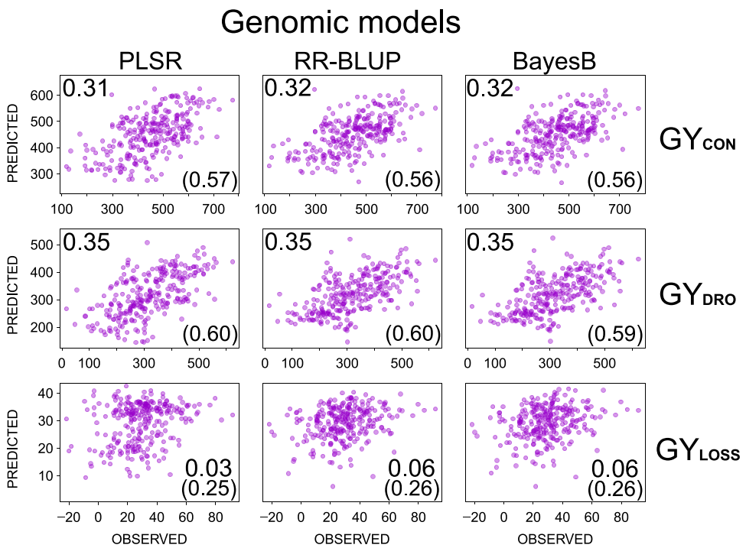
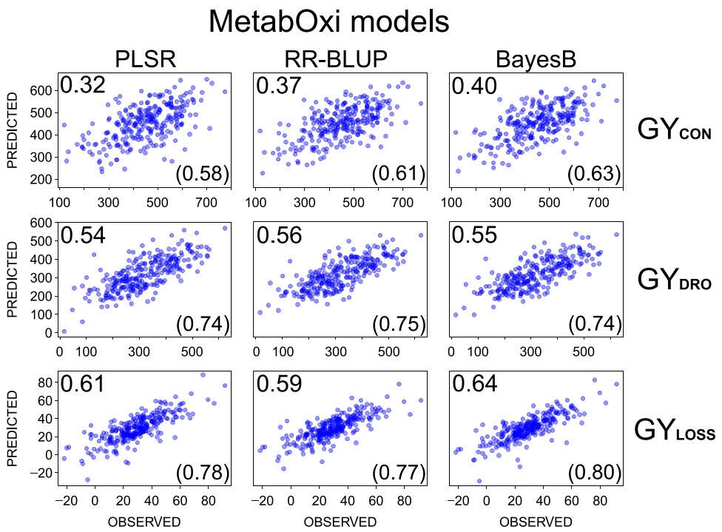
Multivariate models for grain yield prediction
OMICS at the extremes of cellular complexity
Genomics-based models: medium-to-low predictability, lowest for GY_{LOSS} → highest stress dependency.
MetabOxi-based models: medium-to-high predictability, maximum for GY_{DRO} and GY_{LOSS} → high influence of the environment.
Biochemical traits can help to bridge the gap between genomics and plant performance.
Genomic
81K variables
MetabOxi
111 variables
medium
medium
medium
medium-high
low
high

Slide 5
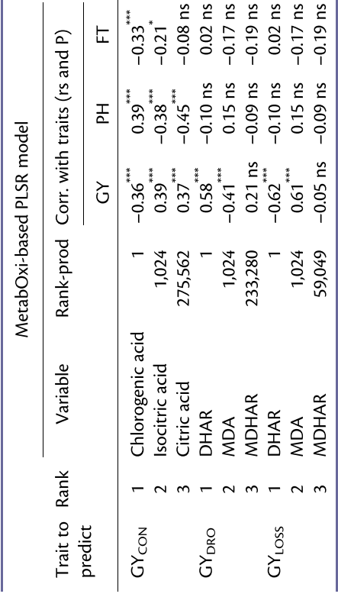
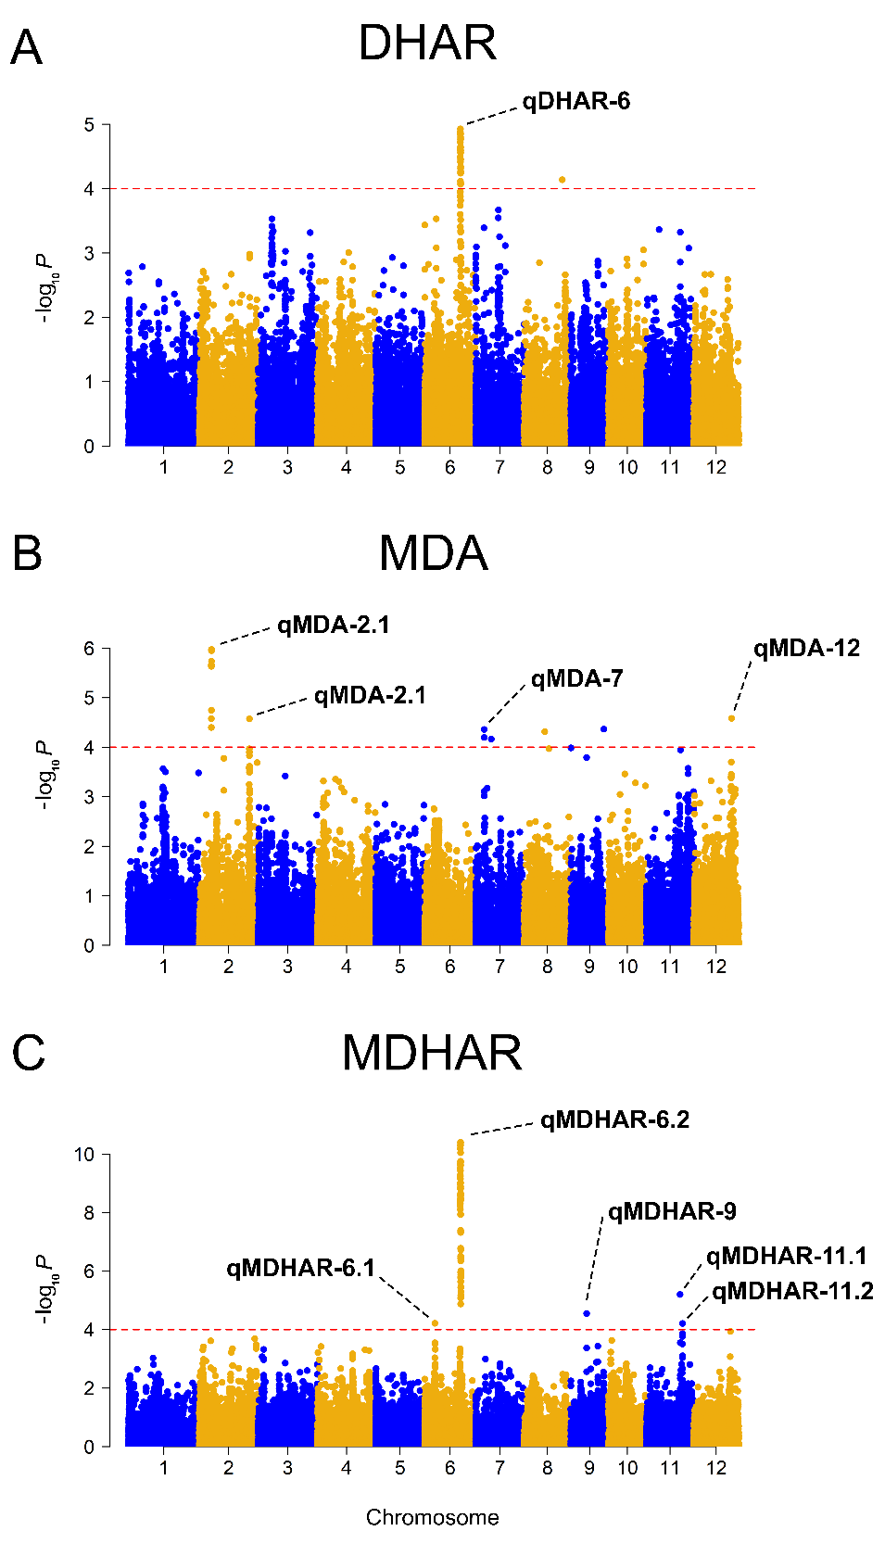
Biomarkers for grain yield stability in rice under drought
During drought, leaf oxidative stress status is more predictive of grain yield performance than central metabolism.
DHAR and MDA are the two best biomarkers for GY_{DRO} and GY_{LOSS}.
These two biomarkers reveal the crucial role of the ascorbate-glutathione cycle in limiting ROS-mediated oxidative damage.
Genetic variation associated with DHAR and MDA values was mapped in the association panel.
DHAR and MDA QTLs (and underlying genes) are promising breeding targets for improving drought tolerance in rice.
Notes:
GY con models were around 0.6 and the top-ranked predictors are highly correlated with PH differences and thus not very good biomarkers.

Slide 6
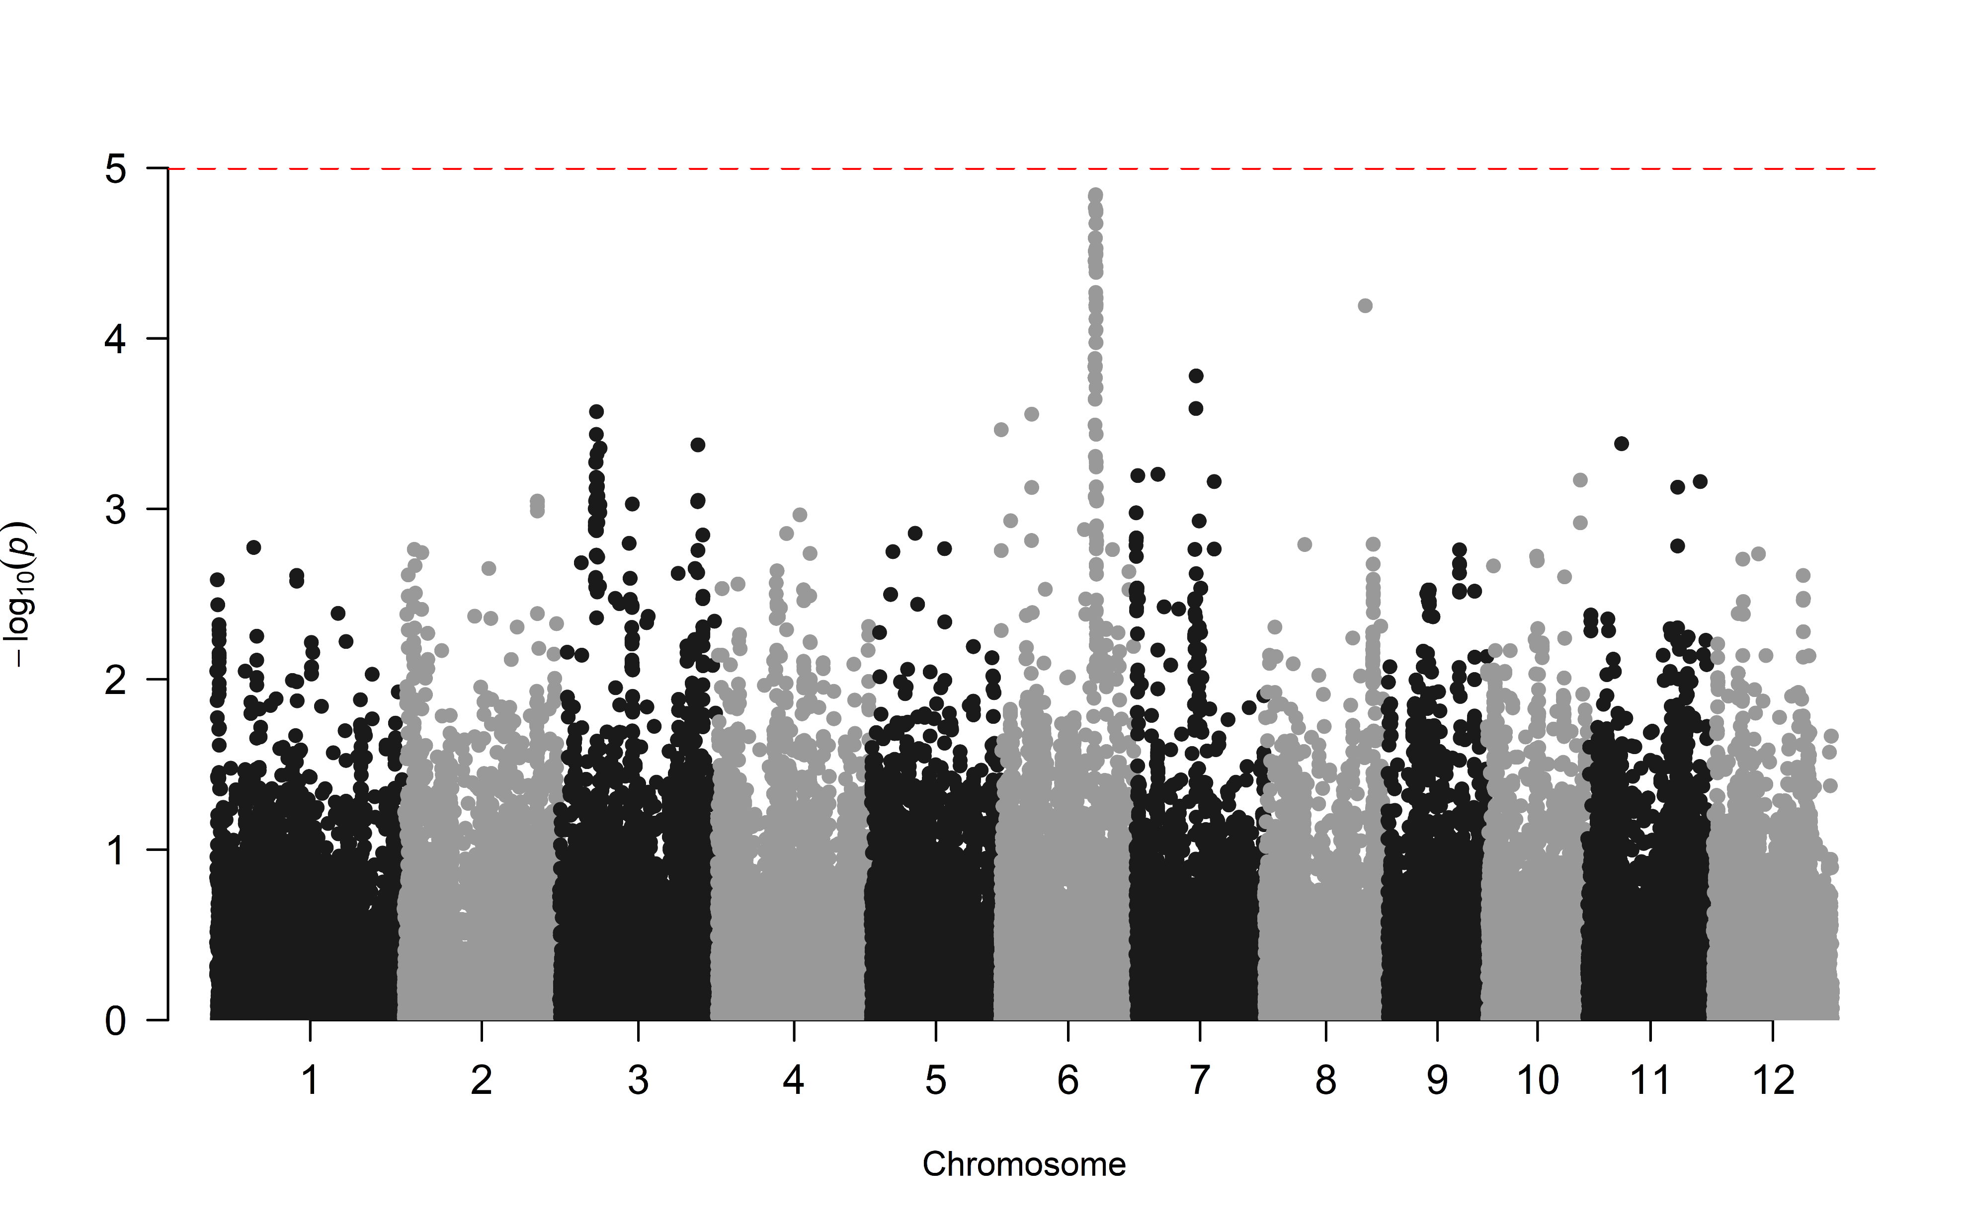
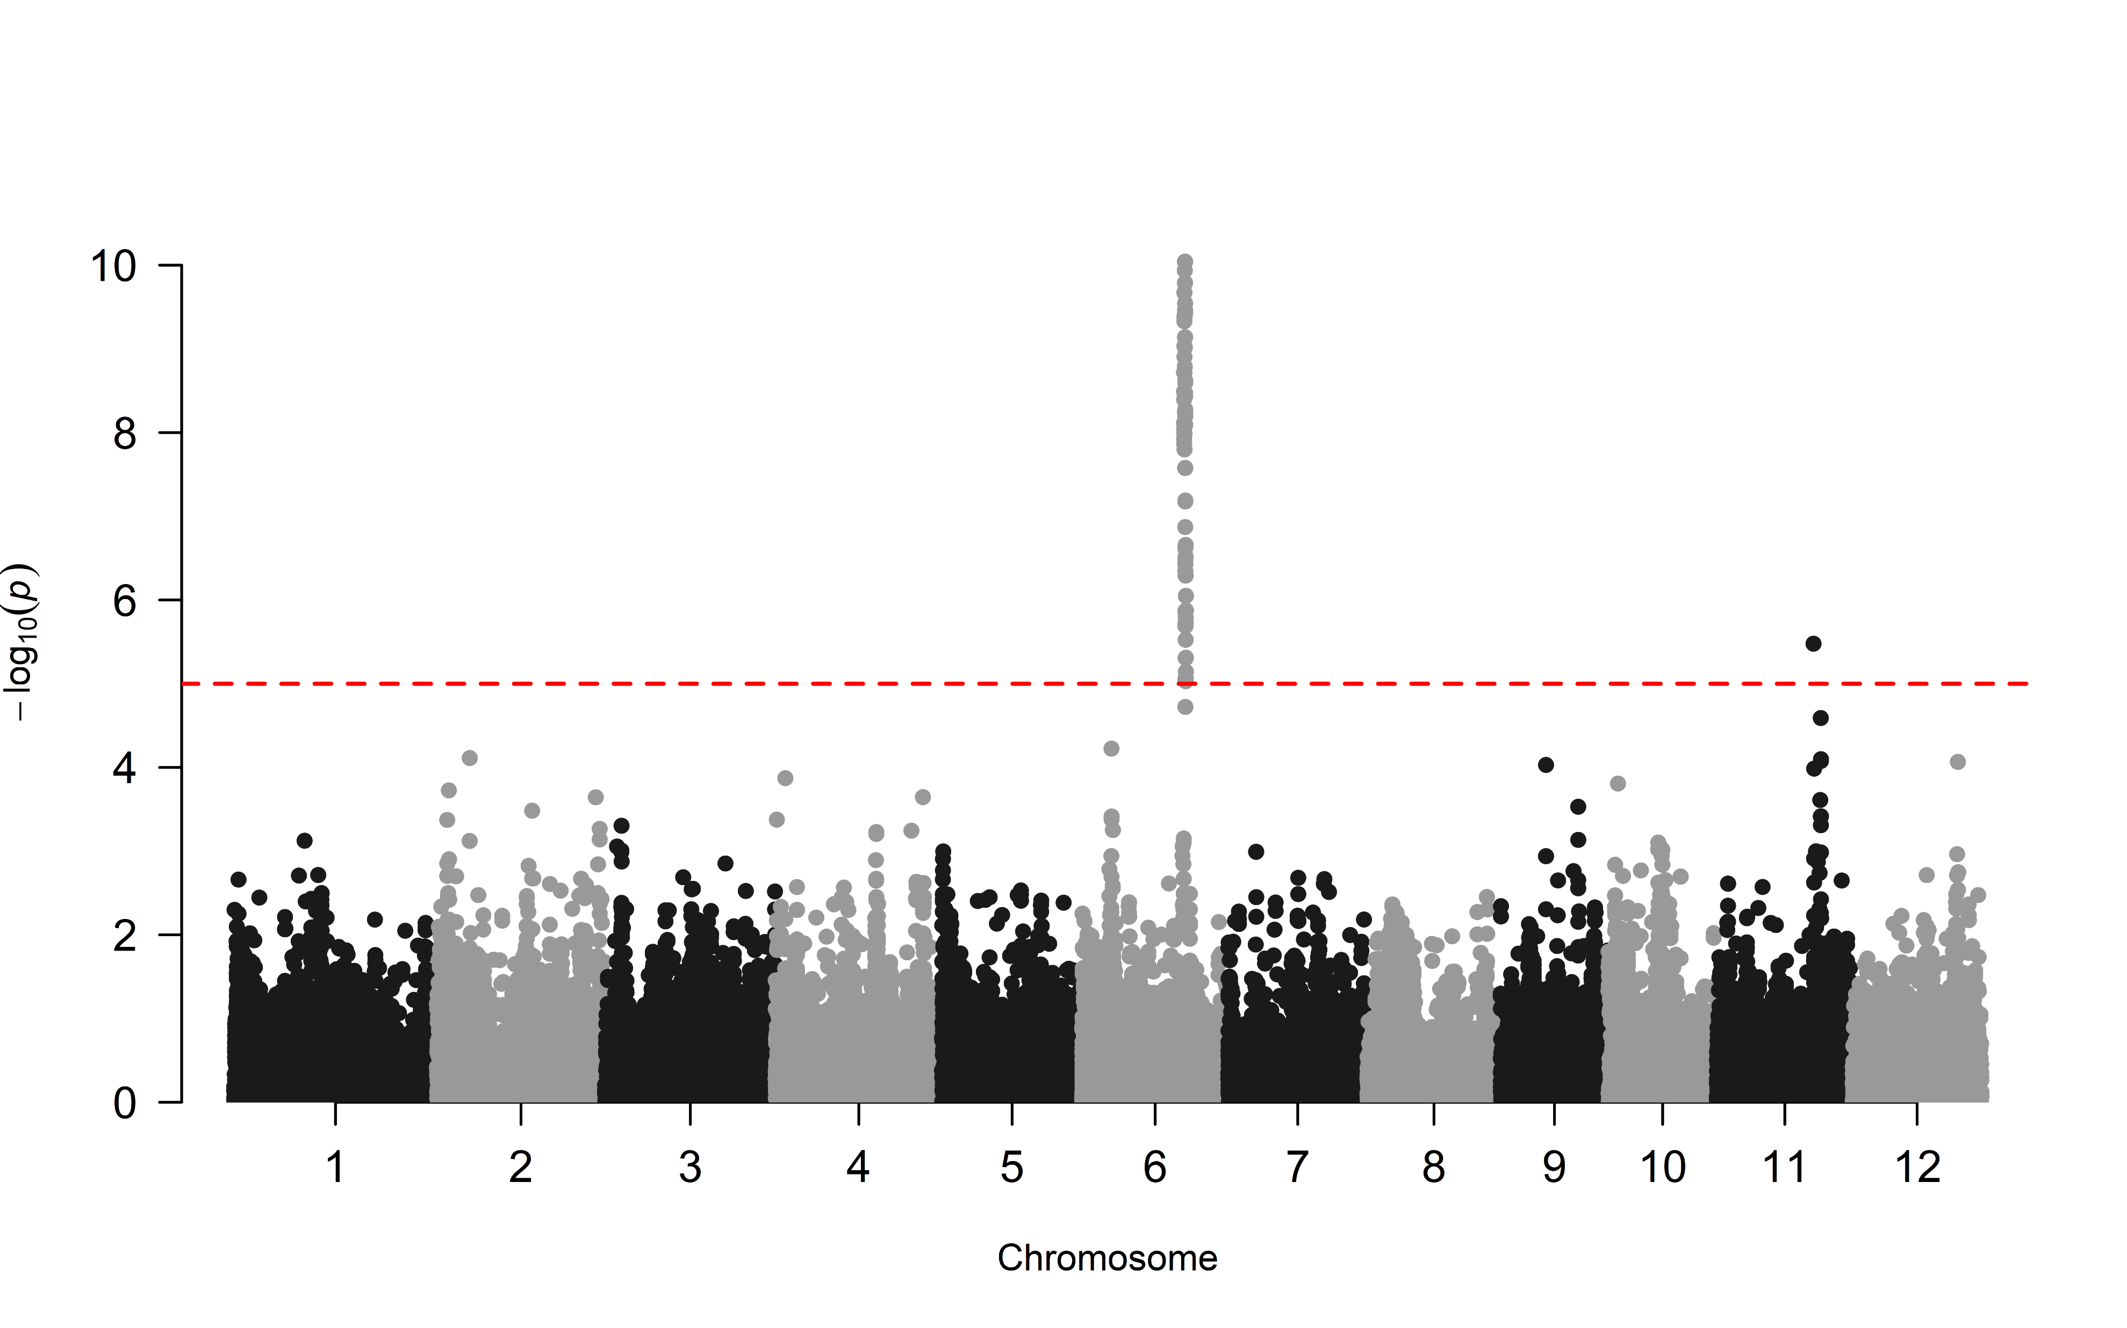
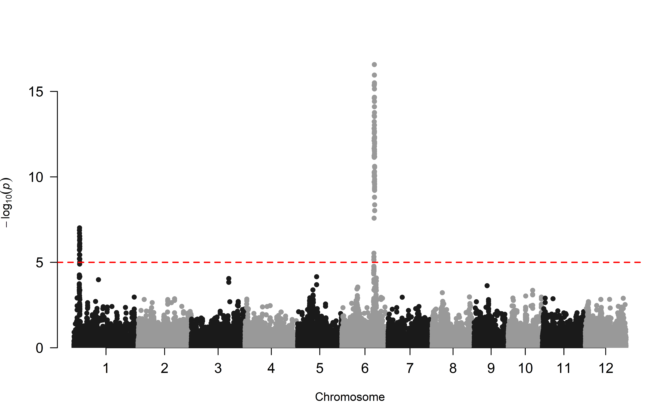
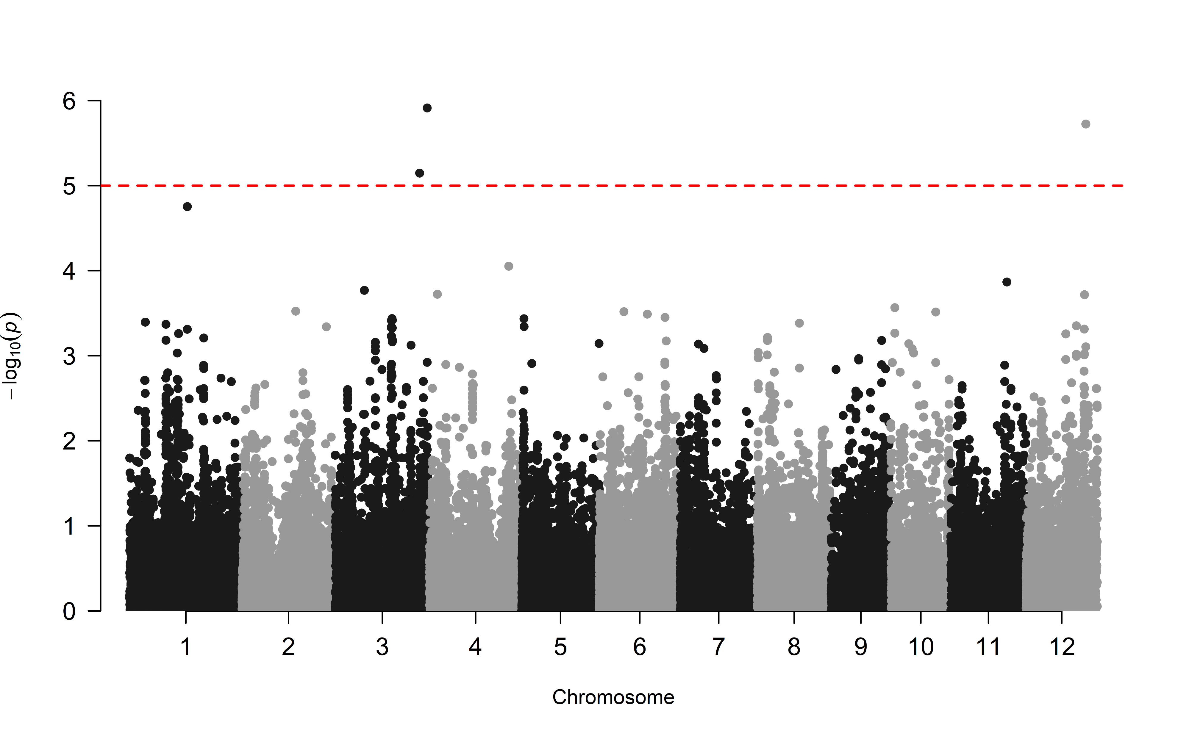
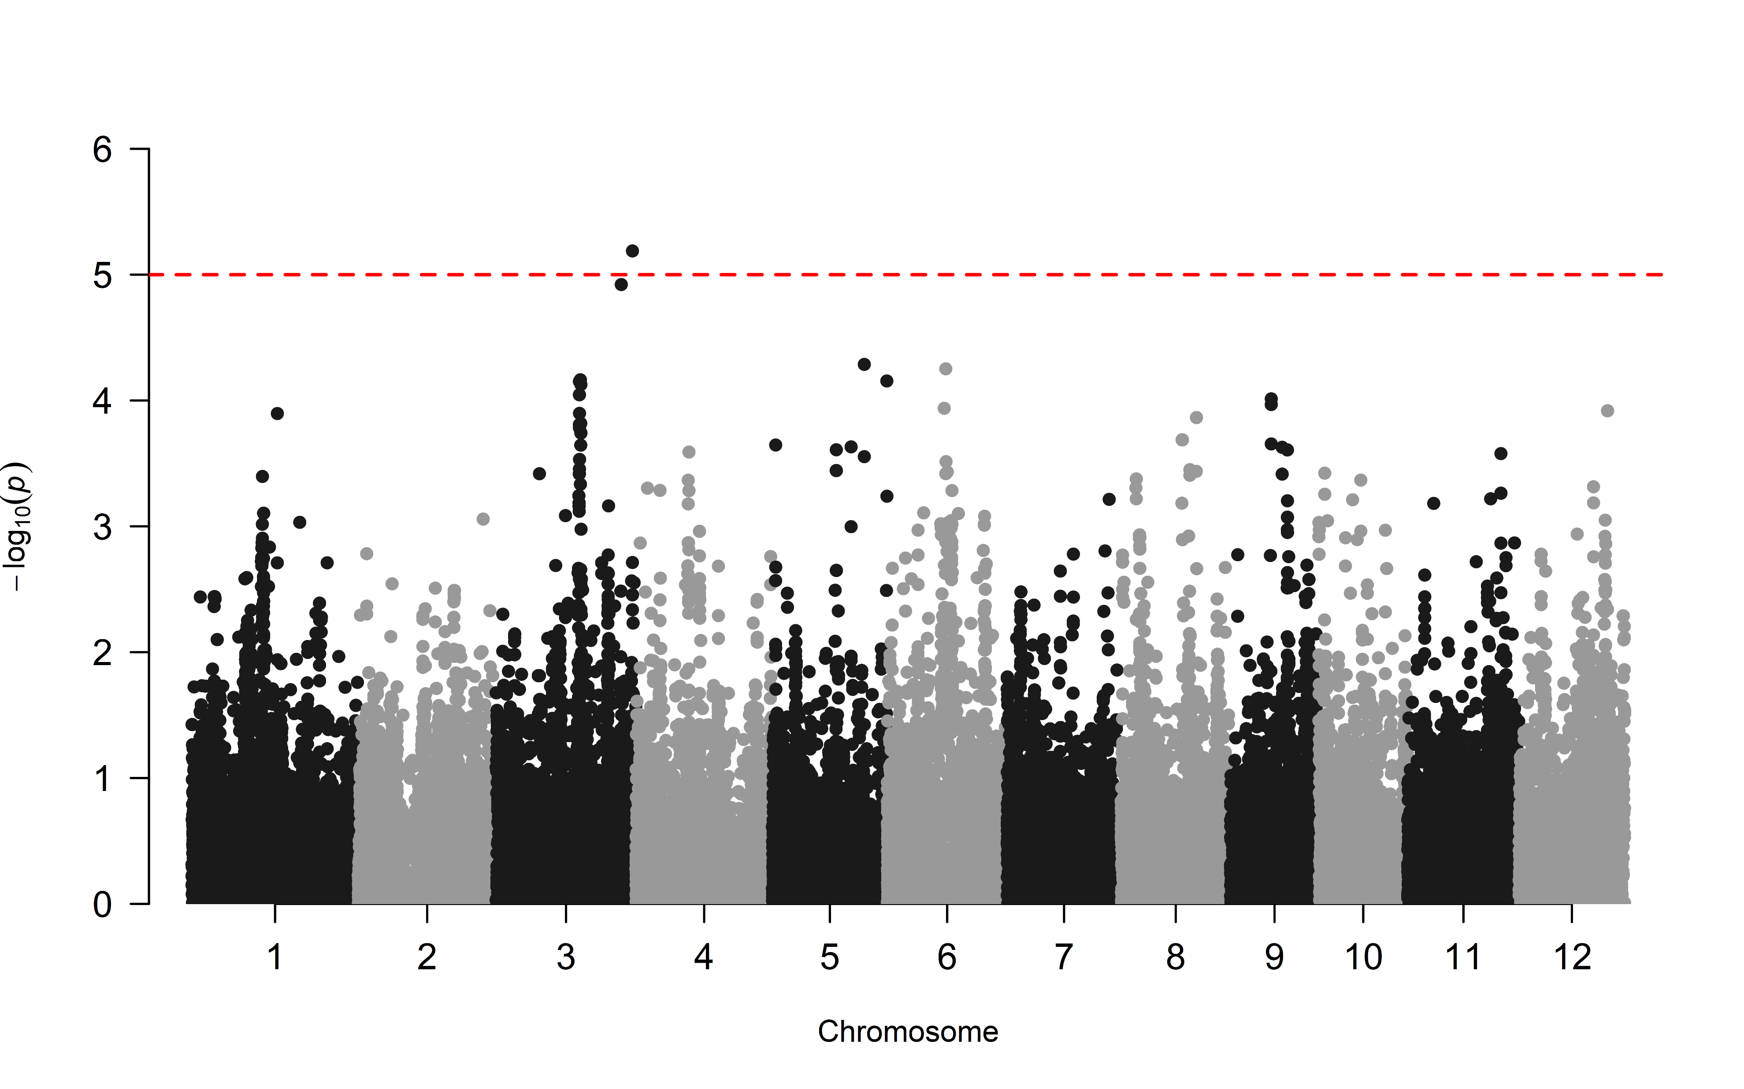
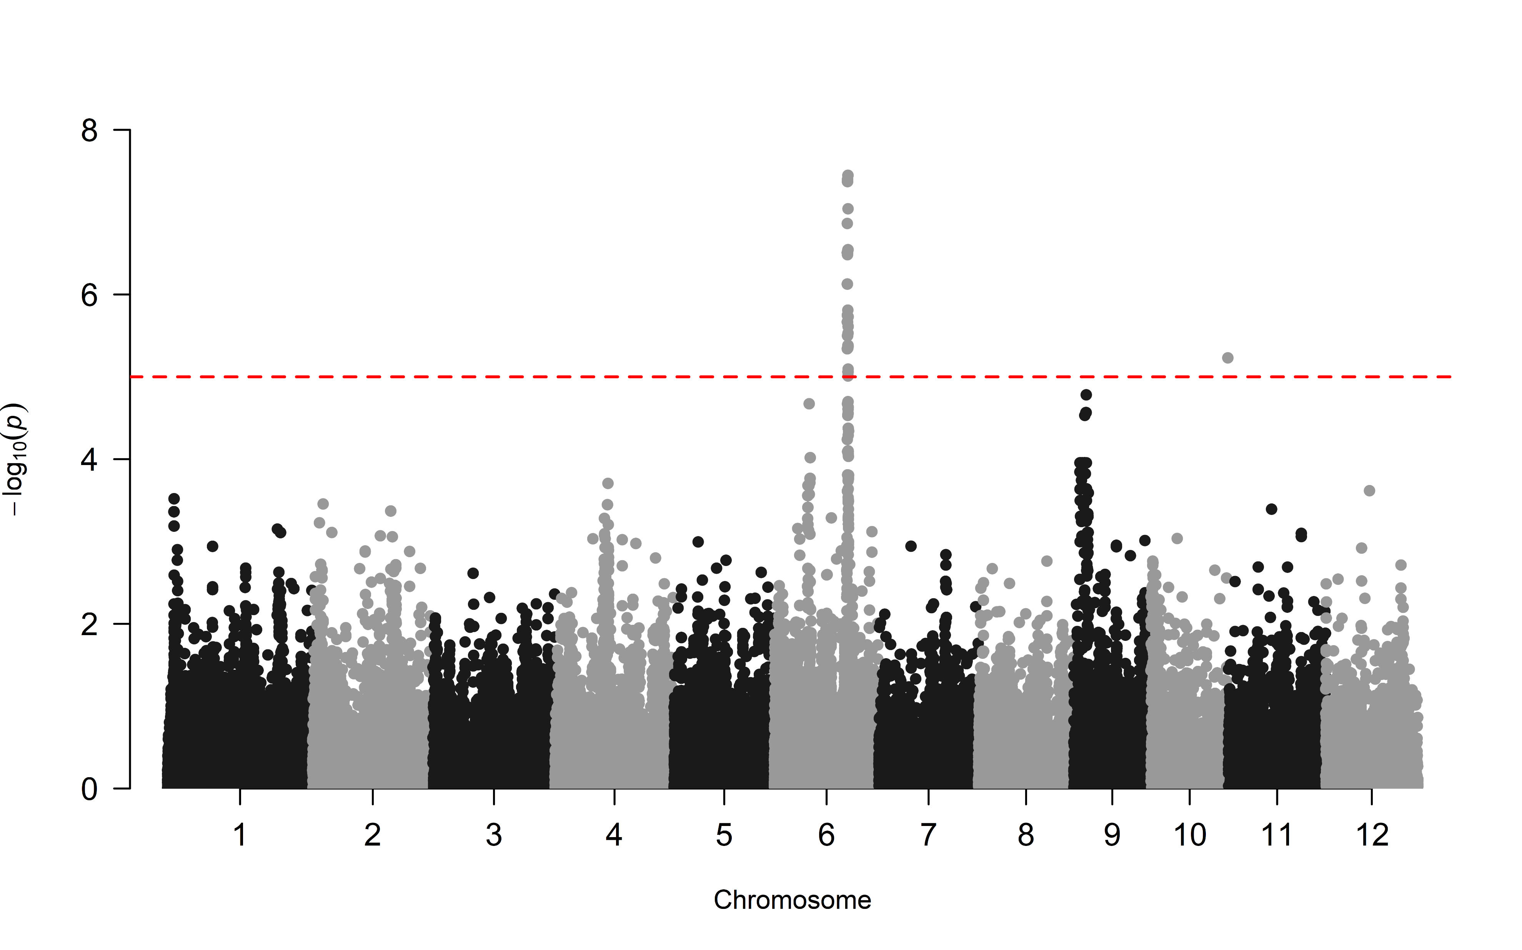
GWAS under the two treatments
DHAR
MDHAR
TAC
DROUGHT
CONTROL

Slide 7
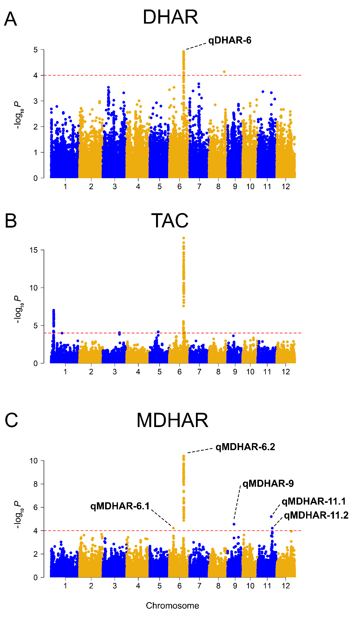
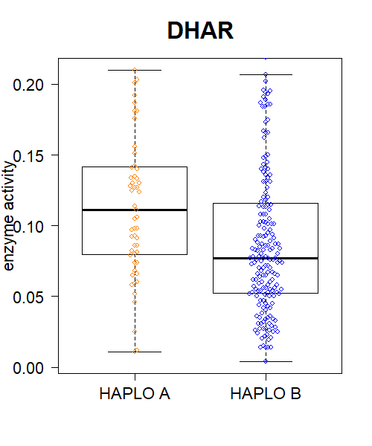
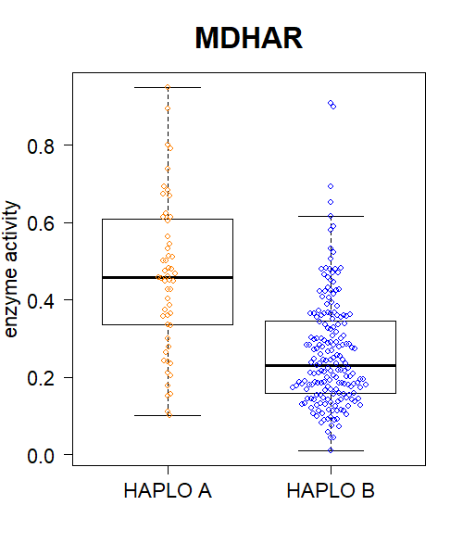
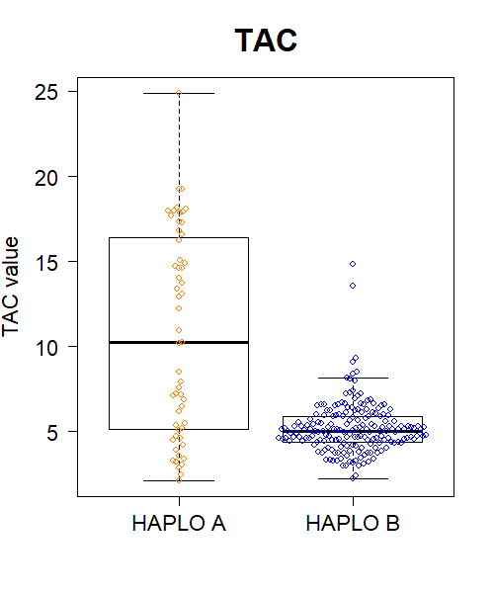
Haplotype analysis of the chromosomal region (120kb – 25 SNPs)
42 kb
16 kb
34 kb
16 kb
8 kb
< 1 kb
< 2 kb
< 5 kb
21,883,335
21,883,406
Trait mapped:
DHAR
DHAR
MDHAR
MDHAR
TAC
21,883,335
21,883,406
21,899,570
Position (bp):
21,841,711
21,883,359
21,883,539
21,933,565
21,954,237
21,883,558
21,883,579
21,933,611
21,933,612
21,933,653
21,933,657
21,935,057
21,935,058
21,951,320
21,951,409
21,951,411
21,953,016
21,954,105
21,954,269
21,954,499
21,955,982
21,964,299
Allele1 (ref):
T
A
G
G
A
G
A
G
G
G
C
G
C
C
C
T
G
A
G
A
G
G
A
A
C
Allele2 (alt):
C
G
A
A
T
A
C
A
A
A
G
C
T
A
A
C
A
T
A
G
A
T
C
T
G
Accessions nr.:
HAPLO A
55
21,899,570
(21,933,611)
HAPLO B
191
SNP density is not high enough to fine map this region.
21,933,565
21,954,237

Slide 8
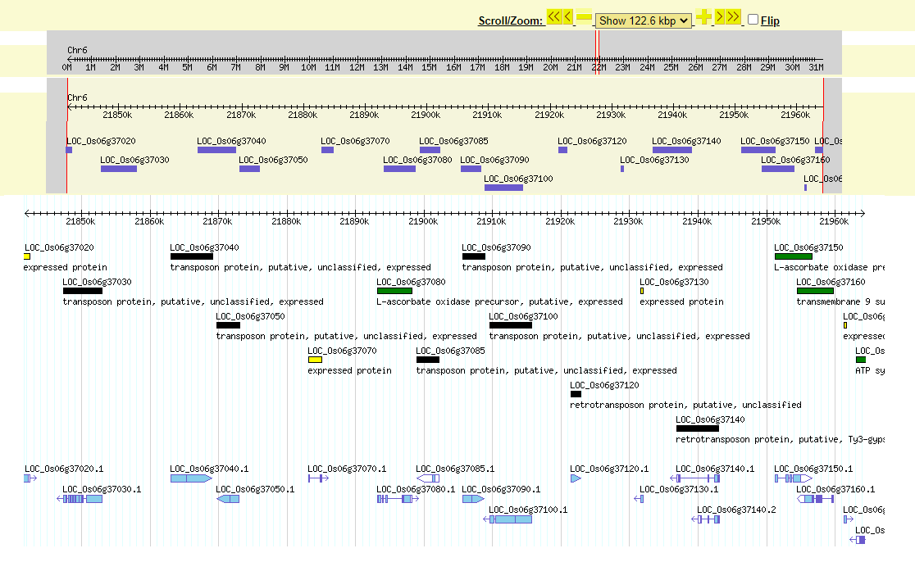
Chromosomal region (120 kb)
OsAAO2
OsAAO1

Slide 9
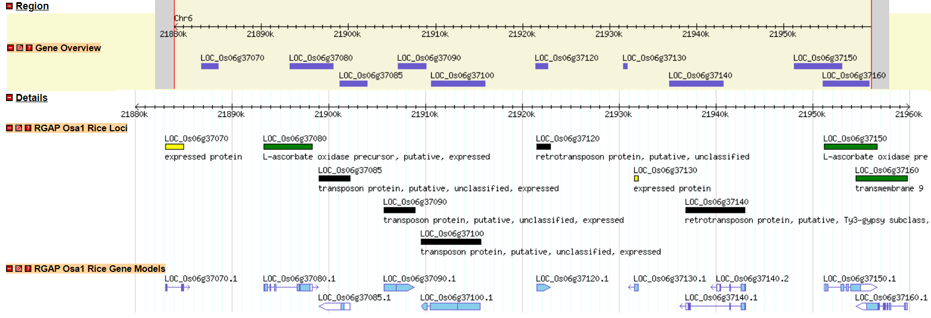
Chromosomal region (80 kb)
DHAR
TAC
MDHAR
MDHAR
OsAAO1
OsAAO2

Slide 10
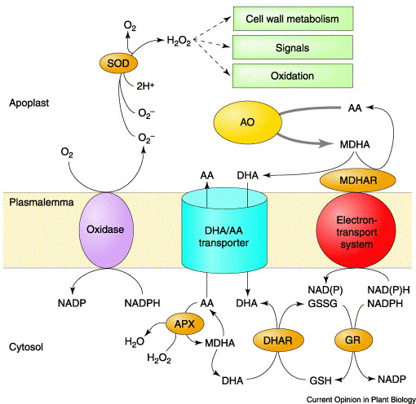
Can biochemistry/molecular biology shed light on Chr6 region?
OsAAO1
OsAAO2
Ding et al. (2020), Journal of Experimental Botany
Pignocchi and Foyer (2003), Current Opinion in Plant Biology

Slide 11
Possible future steps
Biochemical assays for AsA/DHA
Gene expression of OsAAO1 and OsAAO2
Flag leaf powders (more than 100 mg) of all the samples are in Germany (JKI, Berlin)
Long-read sequencing of interesting accessions
SUGGESTIONS ?

